Slide 1
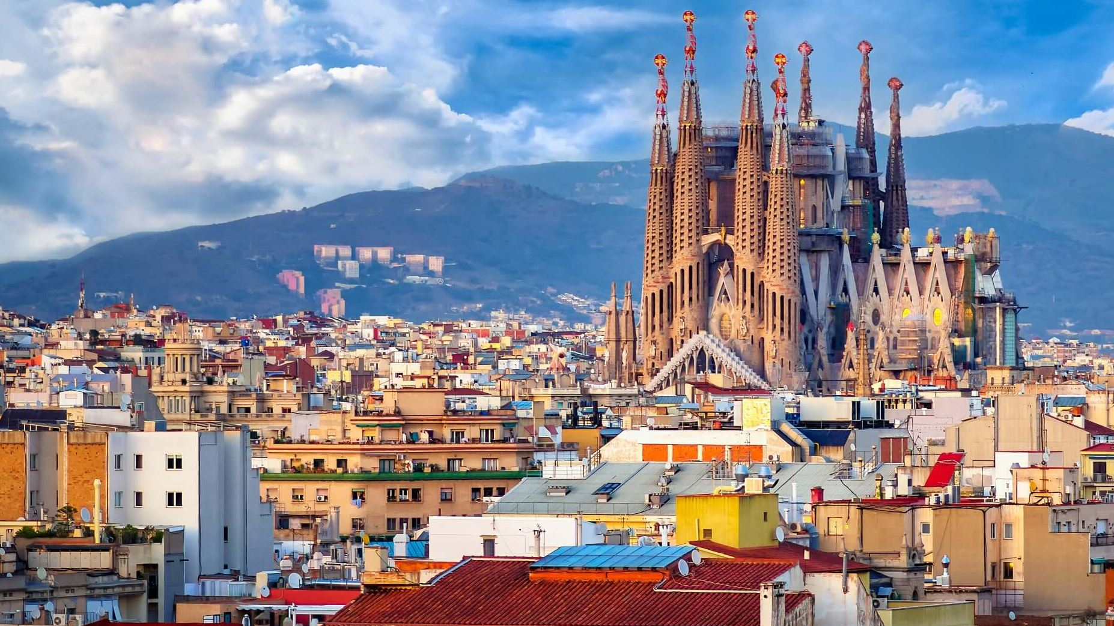
BARCELONA
ENERGY BOOST
3 NIGHTS INCENTIVE PROGRAM

Slide 2
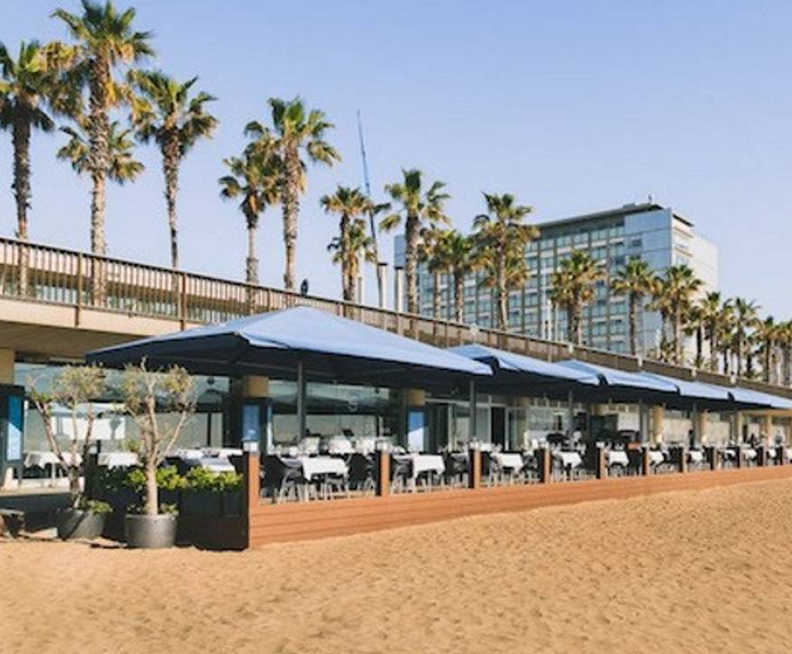
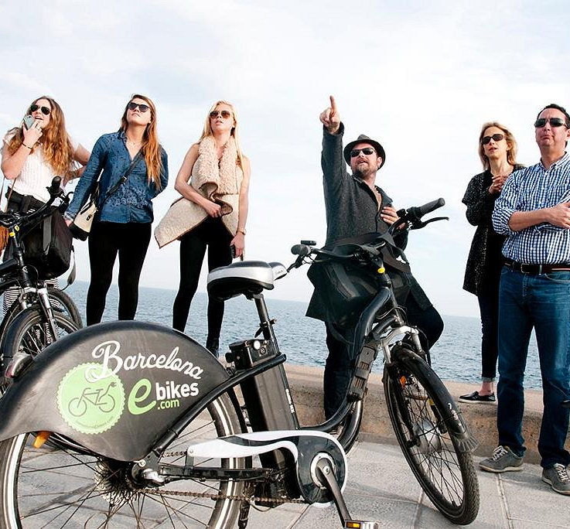
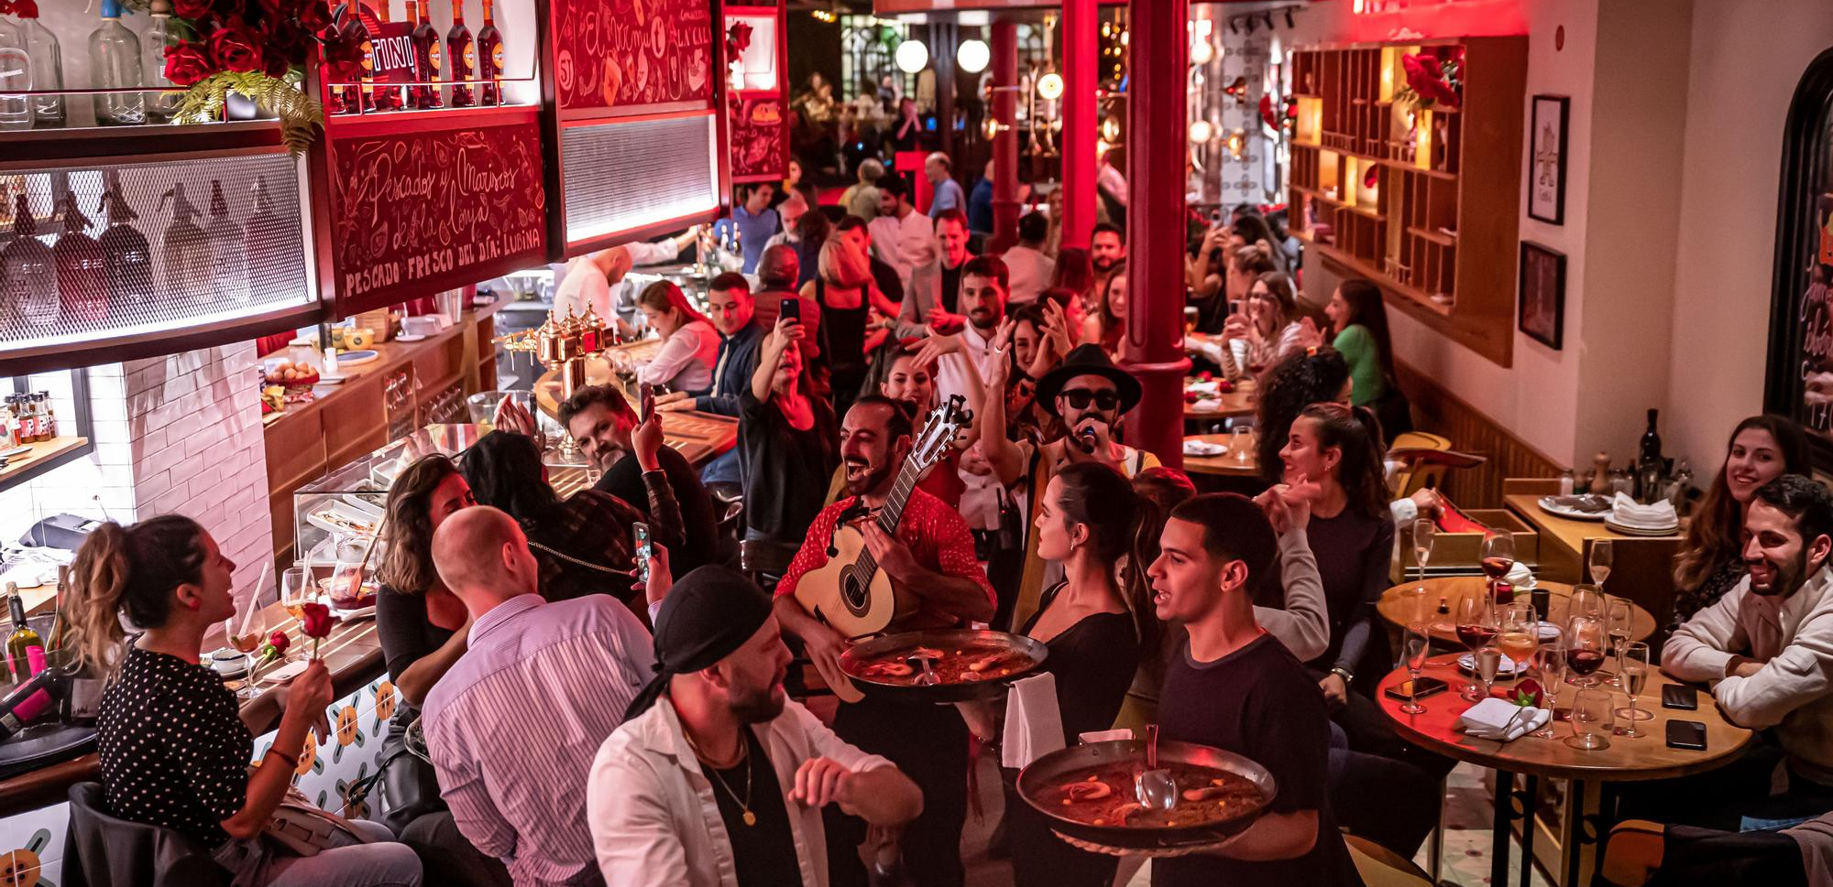
DAY 1: Welcome to Barcelona!
Arrival at Bcn airport & transfer to your hotel. Welcome drink, keys delivery
Transfer to the seaside for a nice paella lunch by the sea, followed by a short e-bike strall on the maritim front.
In the evening, feel the city vibe with a tapas dinner and rumba catalana show in the city center

Slide 3
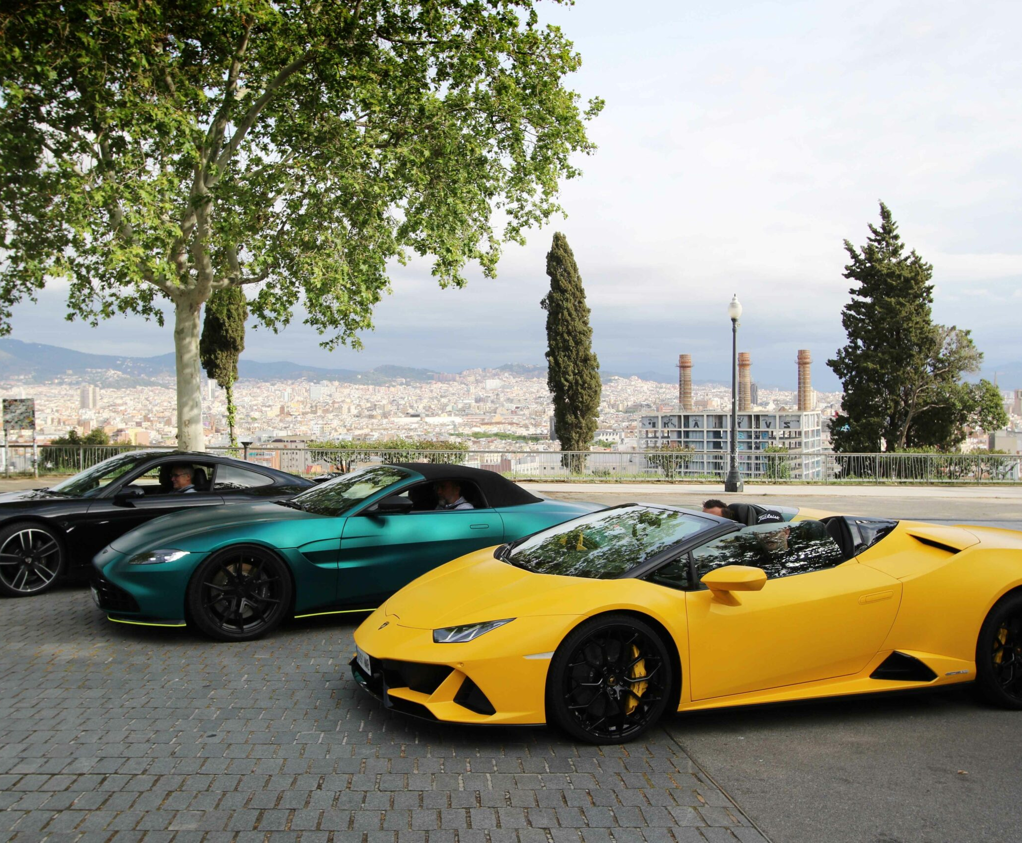
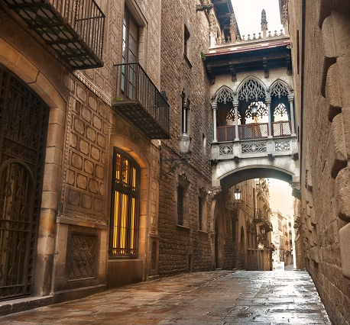
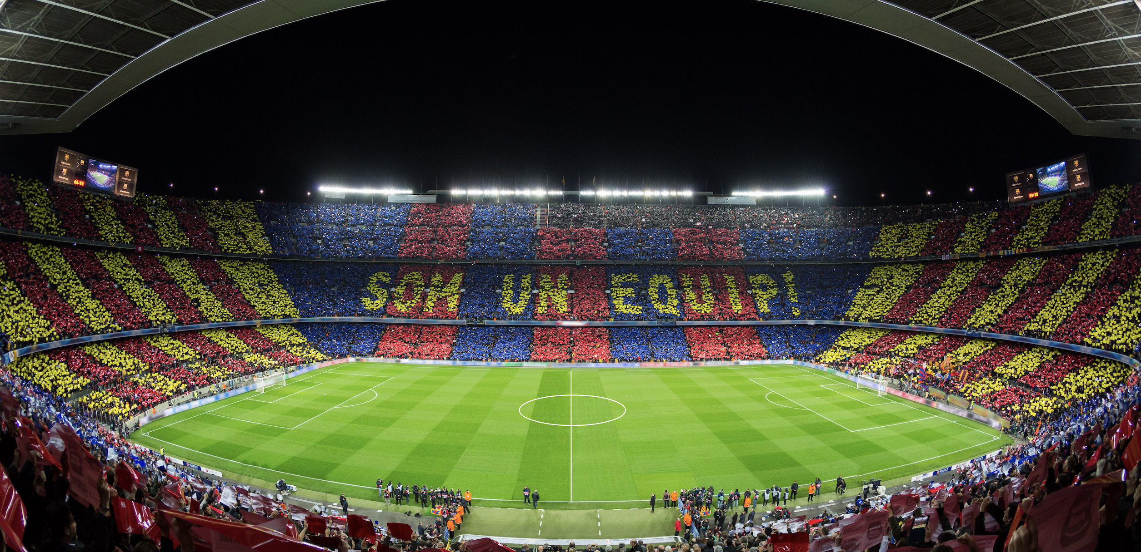
DAY 2: The buzz-y day!
After a nice breakfast at your hotel city center hotel, we will head to Montjuic hill for a thrilling activity: a GT driving experience through the former Montjuic urban circuit, get ready for a speedy sensations!
Lunch by the Montjuic hill, enjoying the views. We will then go back downtown for a nice & funny gimkhana adventure within the old city streets! Let the best team win!
In the evening, we invite you to witness the heart and excitement of the Barça team fighting for victory. An unforgettable way to unwind, connect, and enjoy a guaranteed adrenaline boost!

Slide 4
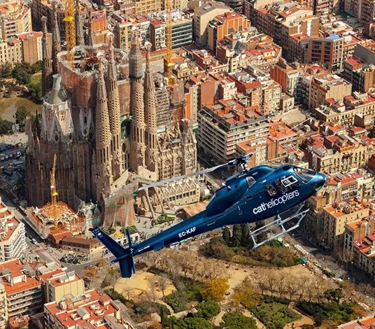
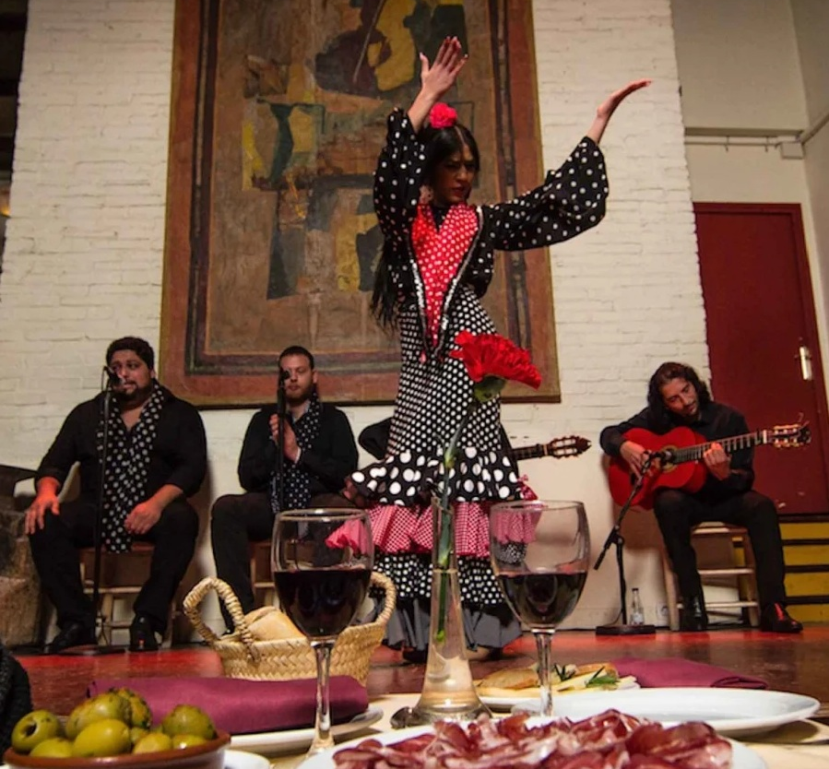
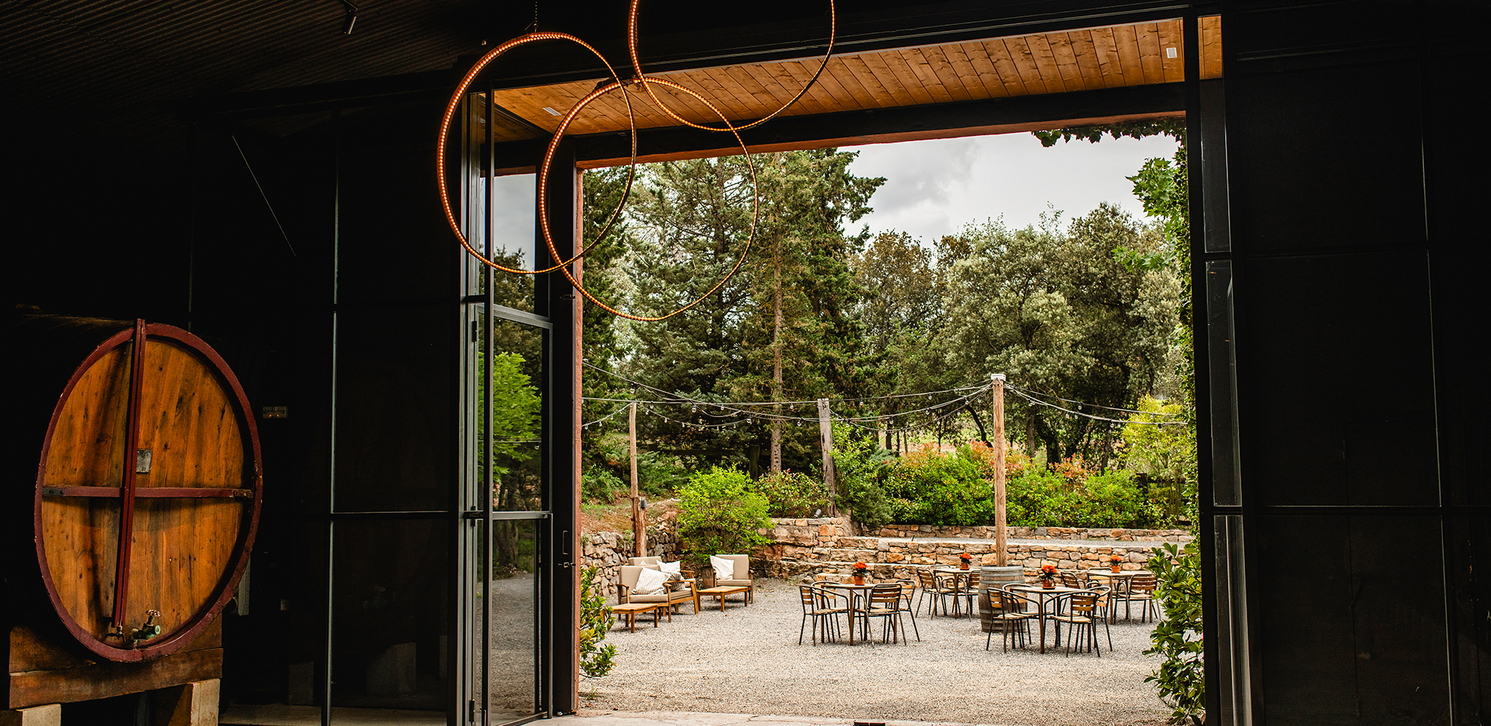
DAY 3: Sky and roots
Let's fly! Live an unforgettable experience with a helicopter flight over Barcelona, the coastline, the Besós river and Montserrat. Architecture, nature and countless secrets to discover along the way. A 60mn activity that can be combined with other activity for bigger groups
After this exciting experience, time to unwind with an excursion to Bages area, where we will enjoy a very special winery visit followed by a wine tasting lunch in the middle of the nature.
For our last evening in the city, we will step into a world where fire meets soul, and every beat, stomp, and strum ignites the air with raw emotion. This is Flamenco at its most electrifying. Set in a typical "Tablao Flamenco", the adventure will begin with a nice sangria cocktail followed by a flamenco masterclass led by the Tablao artists, where we will learn the fist steps of this art. For a bit of fun & challenge, we can set the activity as a contest between the participants. Afterward, we will enjoy the tablao flamenco show in an intimate atmosphere and a delicious and well deserved dinner that will transport us directly to the heart of Andalucia .

Slide 5
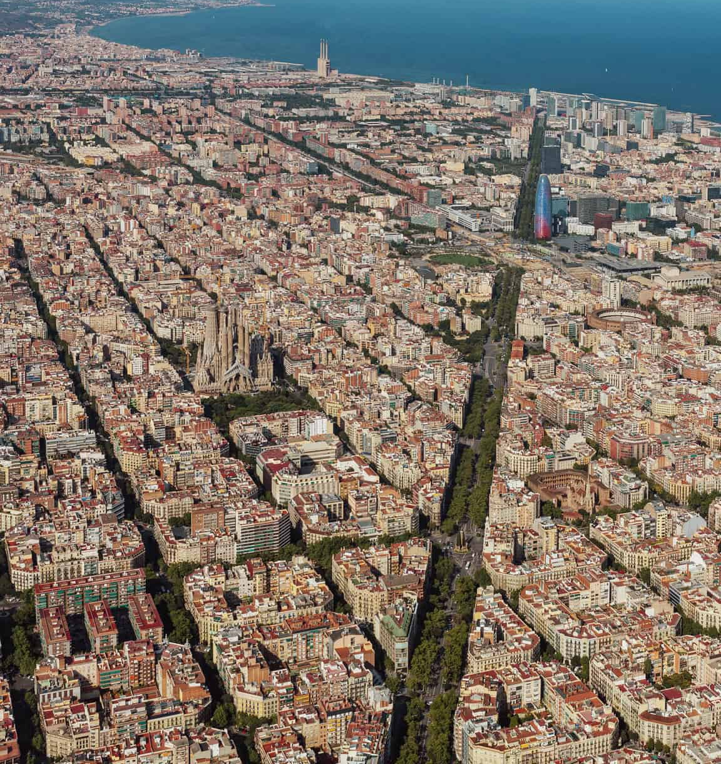
DAY 4: Hasta Pronto!
Breakfast, check out & transfer to the airport
Tell us about your project and we will discuss the best options for your event, according to your budget and special needs.

Slide 6
